Slide 1

President’s Trump
Science Team
George Gamota

Slide 2
President’s Science Advisor
OSTP In 1976, Congress established the White House Office of Science and Technology Policy (OSTP) to provide the President and others within the Executive Office of the President with advice on the scientific, engineering, and technological aspects of the economy, national security, homeland security, health, foreign relations, the environment, and the technological recovery and use of resources, among other topics.
Almost two years into President Trump’s term, the White House Office of Science and Technology Policy (OSTP) is getting a new director. Kelvin Droegemeier was confirmed by the Senate tonight as one of its last acts before the end of the 115th Congress.
OSTP has 4 Associate Directors: Currently none have been nominated or confirmed

Slide 3
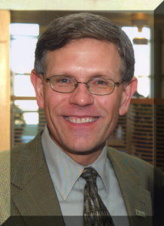
Who is Kelvin Droegemeier
Droegemeier is a renowned meteorologist specializing in severe weather events such as thunderstorms and tornadoes.
He has doctorate and master’s degree in atmospheric sciences and a bachelor’s in meteorology.
Currently the Vice President for Research at the University of Oklahoma, he served on the National Science Board, which oversees the National Science Foundation, from 2004-2016, serving as vice-chair for the last four of those years.
His biography posted there notes that he “helped pioneer the science of storm-scale numerical weather forecasting

Slide 4
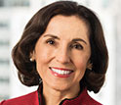
National Science Foundation
Director – Dr. France Cordova
Serves 6 year term
Astrophysicist
Nominated by President Obama in 2014

Slide 5
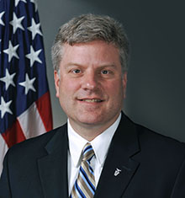
DARPA
Director – Dr. Steven Walker
Aerospace engineer PHD
Appointed Nov 13th 2017
Previously he was Deputy Director from 2012 to 2017

Slide 6
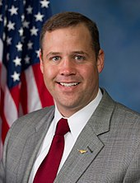
NASA
Director – Mr. James Bridenstine
Congressman from Oklahoma (2013-2018)
Graduate of Rice Universitywith majors in Economics, Psychology, and Business, and has an MBA from Cornell University.
Naval Aviator in both the active duty United States Navy and the United States Naval Reserve

Slide 7
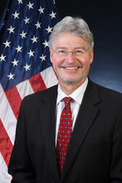
National Institute of Standards and Technology NIST
Director – Dr. Walter Copan
Also Under Secretary of Commerce
Confirmed on October 5, 2017
Dual B.S./B.A. degrees in chemistry and music from Case Western Reserve University in 1975, Dr. Copan began his career in chemicals and materials research at the Lubrizol Corporation
He earned a Ph.D. in physical chemistry from Case Western in 1982

Slide 8
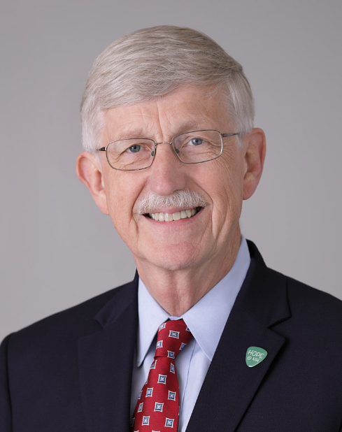
NIH
Director –Dr. Francis Sellers Collins
Assumed office in 2009
American physician-geneticistwho discovered the genes associated with a number of diseases and led the Human Genome Project.
He has been elected to the Institute of Medicine and the National Academy of Sciences, and has received the Presidential Medal of Freedom and the National Medal of Science

