Slide 1
Buying and selling on eBay
eBay connects buyers and sellers worldwide
  How it works
  How to sign up
PayPal
  How it works
  How to sign up
The process of selling
Feedback, feedback, feedback
Things that I have bought and sold
Bob Eckert 12/14/2011

Slide 2
eBay: How it Works: Buying
Create account
Create PayPal account
You are ready to bid / buy it now
Bob Eckert 12/14/2011

Slide 3
eBay fees
Insertion fee
Final value fee (based on sale price of item
Detailed information on fees at:
http://pages.ebay.com/help/sell/fees.html
Bob Eckert 12/14/2011

Slide 4
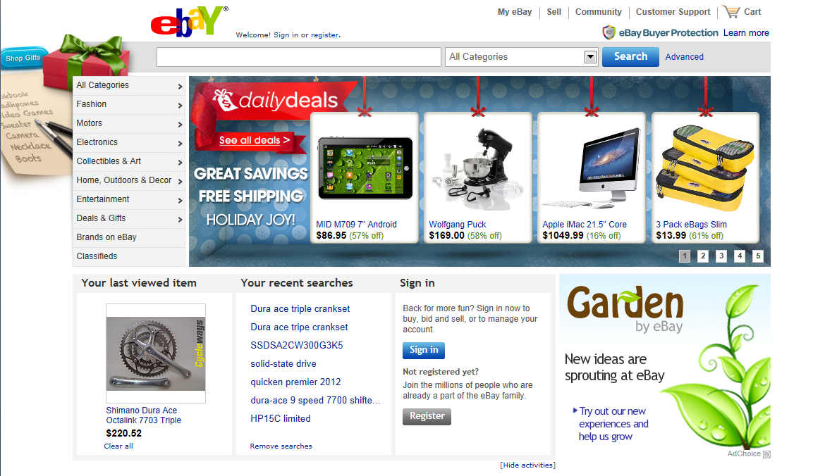
http://www.ebay.com/
Bob Eckert 12/14/2011

Slide 5
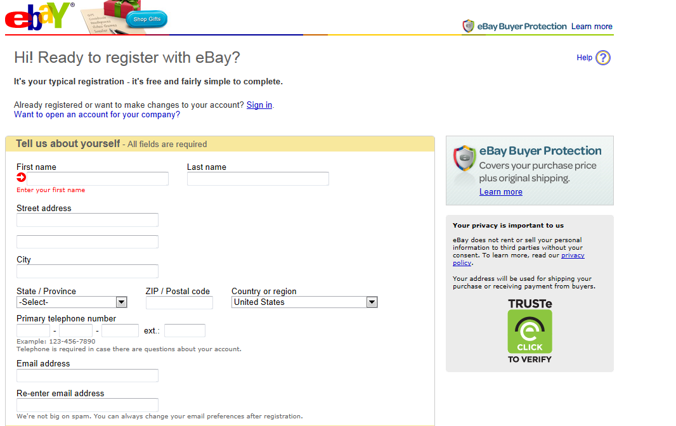
eBay registration
Bob Eckert 12/14/2011

Slide 6
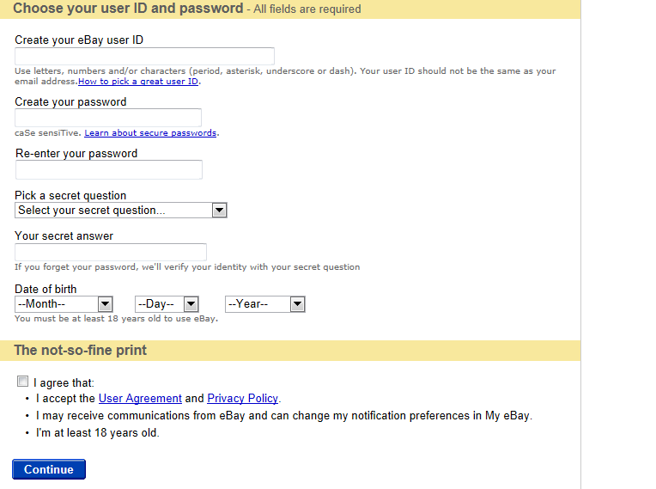
eBay registration (continued)
Bob Eckert 12/14/2011

Slide 7
PayPal
PayPal account allows secure transfer of funds between buyer and seller
If I buy something, I log into my PayPal account and give directions to pay the seller
I give PayPal that individual’s email; PayPal sends email that funds have been transferred to the seller.
Funds go from my bank account to seller’s PayPal account
Seller can withdraw funds to his bank account or leave in PayPal account
Bob Eckert 12/14/2011

Slide 8
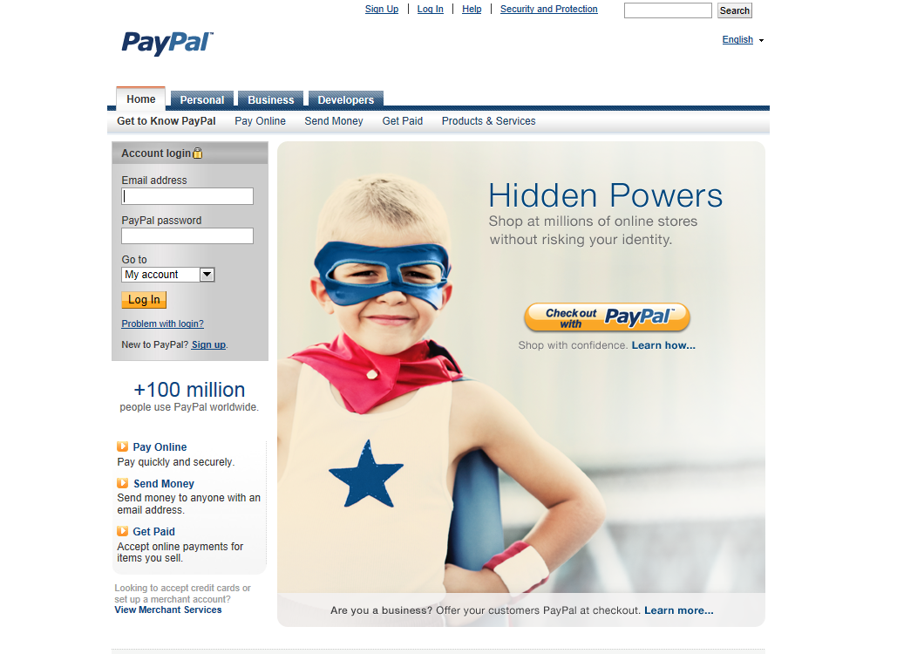
PayPal registration
Bob Eckert 12/14/2011

Slide 9
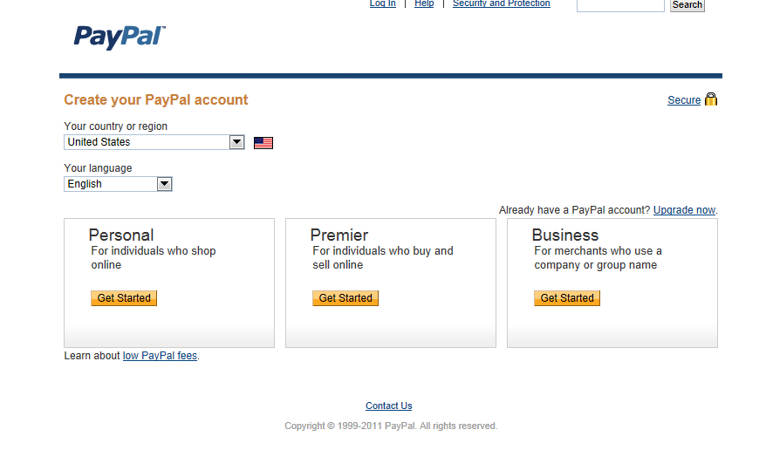
PayPal registration
Bob Eckert 12/14/2011

Slide 10
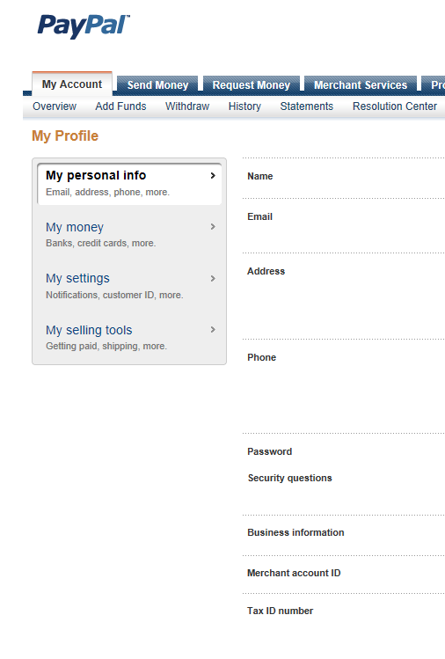
PayPal account
Note: when registering, a link to bank account is set up
Bob Eckert 12/14/2011

Slide 11
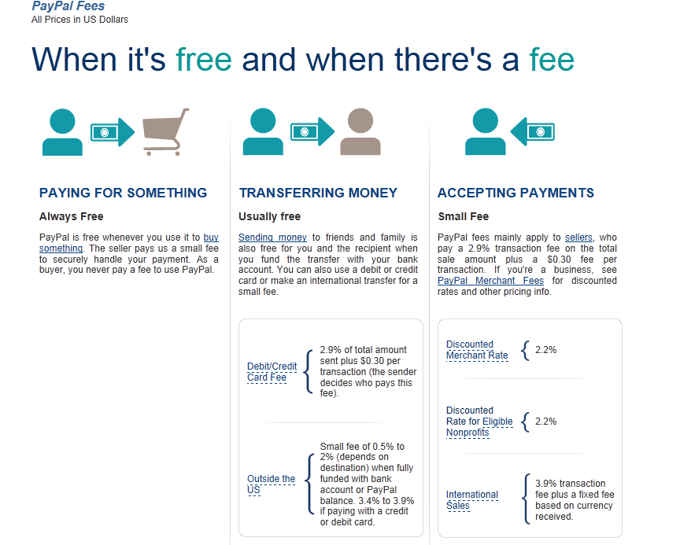
PayPal fees
Bob Eckert 12/14/2011

Slide 12
Buying
Bid (up to maximum)
Buy it now
If successful, will receive emails confirming, and requesting payment
Go to eBay and then to PayPal to send funds
A good seller will confirm receipt of funds AND confirm shipping.
Bob Eckert 12/14/2011

Slide 13
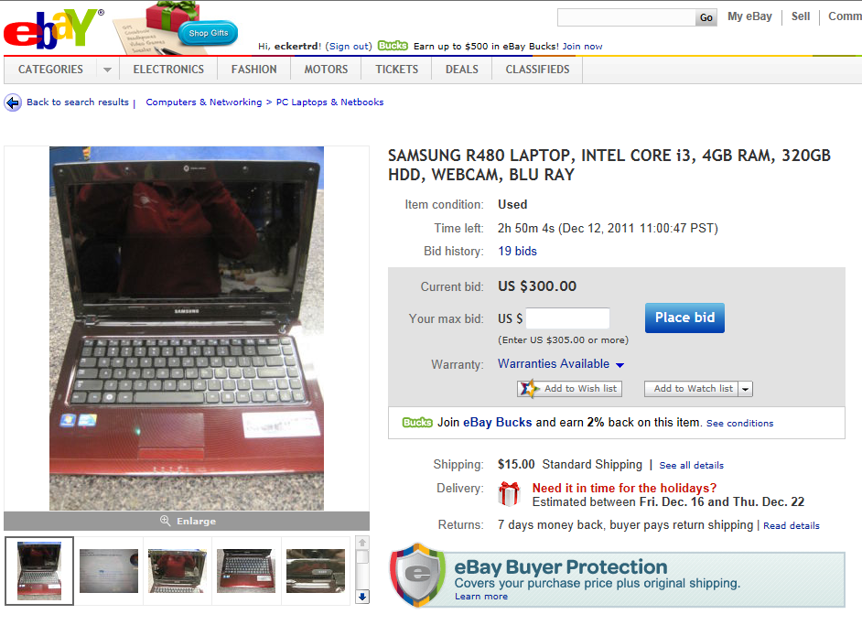
Selling
Good ad has good pictures (critique this one)
Bob Eckert 12/14/2011

Slide 14
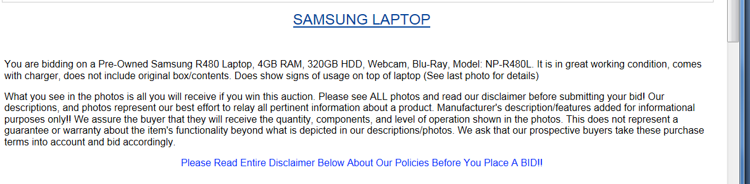
Good ad has good description
(note omissions in this one)
Bob Eckert 12/14/2011

Slide 15
Link to ad with good pictures / thorough description
http://www.ebay.com/itm/Samsung-NP-RV520-W01US-15-6-HDD-Backlit-LED-640gb-4g-WiMAx-Enabled-Notebook-/300615800705?pt=Laptops_Nov05&hash=item45fe191781
Bob Eckert 12/14/2011

Slide 16
Things that I have bought / sold
Vintage glass salt spoons (purchased)
Shimano MTB 9 speed cassette (purchased)
Shimano triple chainrings (purchased)
Shimano road bike shifter (purchased)
RESPeRATE biofeedback unit (sold)
Specialized bicycle saddle (purchased)
Memorex external CD / RW drive (sold)
Terry bicycle saddle (sold)
etc., etc.
Bob Eckert 12/14/2011

Slide 17
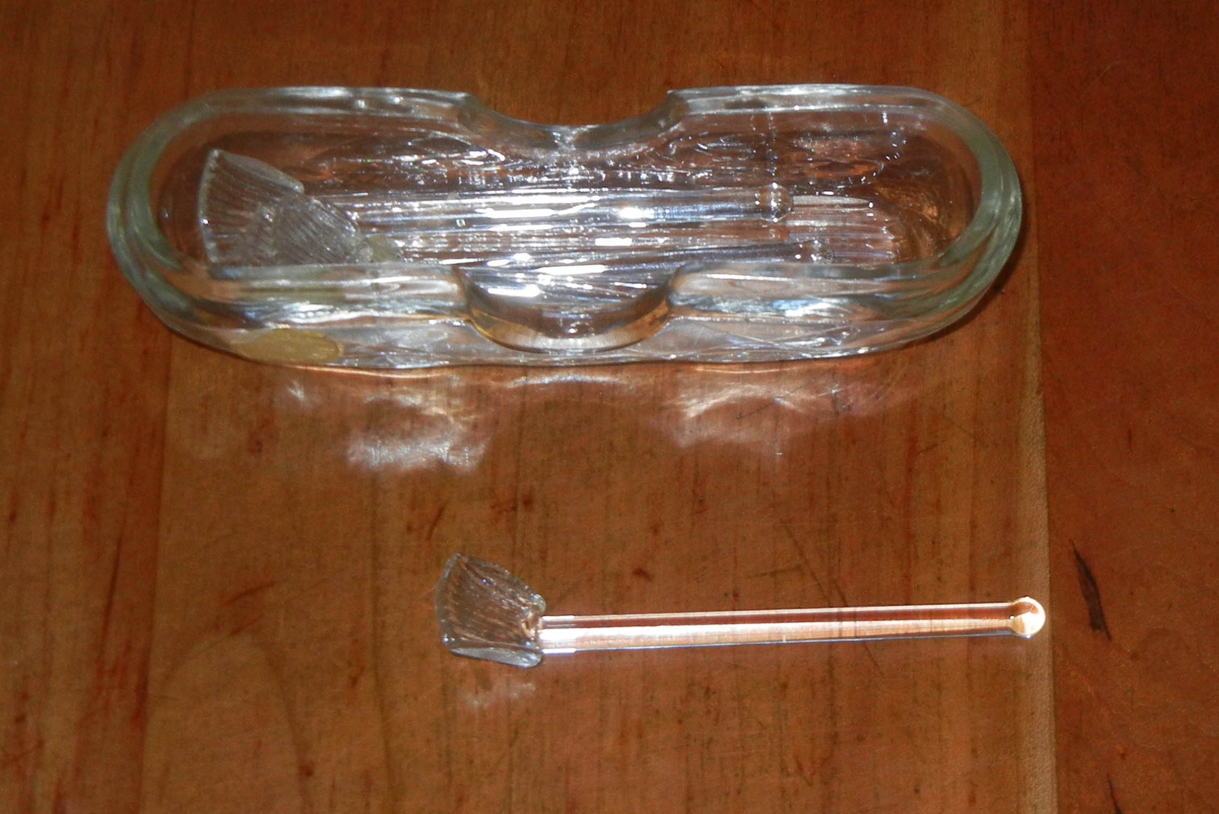
Antique salt cellar spoons
(to replace a broken one)
Bob Eckert 12/14/2011

Slide 18
Live demo
http://www.ebay.com/
Bob Eckert 12/14/2011

Slide 19
Bob Eckert 12/14/2011

