Slide 1
Creating Greeting Cards with Digital Stamps
October 26, 2011
Presenter
Marion Davis

Slide 2
Types of Cards
Before we start I would like to explain that there are 3 basic types of cards:
Physical cards created with cardstock, decorative papers, rubber stamps and embellishments.
Digital cards which are created in your computer using various programs and then printed out.
Hybrid cards…my personal favorite… which uses the computer to generate images and sentiments but are then cut into elements and assembled as one would a physical card.

Slide 3
Searching and collecting
Before we start I want to warn you that this is very addictive. I keep my digi-stamps on an external hard drive. Memory devices will work well too. I suggest you sort them into folders as you save them because it will make it easier for you to find what you want. You can use your photos but I will wait to discuss that for when we do scrapbooking because the layering techniques are more involved and are needed when you want to use a photo and possibly frame it or layer it on a decorative background.

Slide 4
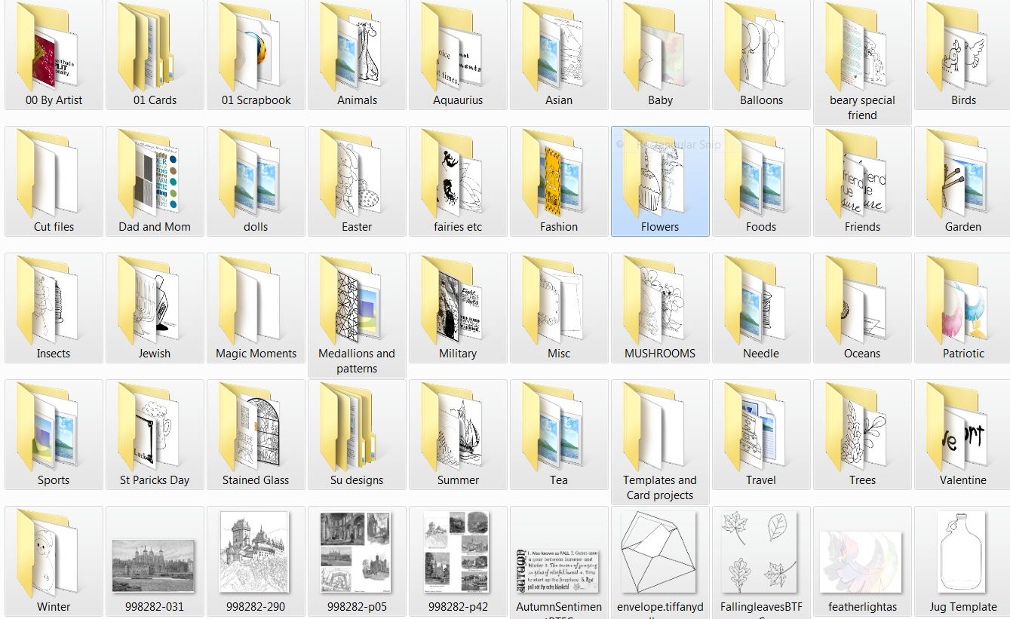
Folder Example

Slide 5
JPG or PNG
You may wonder which format to save if more than one is offered. The answer is BOTH JPG and PNG. The reason is that JPG or JPEG gives you an opaque background and PNG is on a transparent background. The transparent background is more important in scrapbooking; however you may wish to combine images and the transparency will be important there. O the other hand you may want the white background masking a part of the image and so you would use the JPG version.

Slide 6
Programs Needed
Word
A program to unzip compressed files
  Win Unzip
  Win RAR
  FY Zip
  7-Zip
  There are several others. Just Google for unzip free
Notes:
Also you will very likely need a program to unzip zipped or compressed files. There are several on the internet. Some are free and some are low cost to register after a free trial. My recommendation is to try several on the free trial in sequence so you use it for the free periods to find out which one you prefer. Then if there is a registration fee it is nominal and you know you have the one you want.

Slide 7
Finding Stamps preferably Freebies
Start by searching Google for Free digital stamps. As you explore, either bookmark the sites you like of sign up for their newsletters or feeds depending on how much mail you want to receive. If you bookmark, you will need to check the sites regularly.
If you are saving Freebies you need to save them when you see them. This is because most sites only offer them for a short time. Many “stores” offer occasional freebies. Then they become available for sale. Be careful what you select if you do not wish to pay for them. As a note here Digital stamps are the least expensive types of stamps available. I have paid for many I really wanted.

Slide 8
What are Digital Stamps
Basically, digital stamps are line drawings that you print and then color just as you would with a regular stamp. For those of you well versed in PhotoShop or similar programs it is possible to color them digitally but I will not be addressing how to do that at this time.

Slide 9
Enhancing or Decorating your Stamps
You may use colored pencils, watercolors, or any markers you may own. If you are familiar with stamping techniques they all work with digital stamps.
Some things to take into consideration are the type of paper you use and your printer ink. Some printer inks will smear depending on the coloring medium you're using. Some will run if you use watercolors or water based dye inks. Spraying with a workable spray fixative will inhibit inks from bleeding when you color. Be sure to let the ink dry completely before you attempt to color. I usually print my work the day before I color it. However, my life seems to be a case of “If it weren’t for the last moment many things would not get done.” If this is the case heat set your printed pages with a heat tool.

Slide 10
Creating your card in Word
Most people just use Word to resize and print out their images. It works just the same as inserting a picture and resizing to print. If you're comfortable using a graphics editing program like Photoshop Elements you can also resize, edit the picture (crop out or mask parts of the image). Another benefit of digis is that you can flip the image. They are a lot of fun and there is a lot of information in the digi forums on how to use them and different techniques. But there are some decisions to make.

Slide 11
First decision after finding the image and/or sentiment you want to use is the way you want to use your cardstock. Will you cut it in half and make 2 cards or will you just fold the paper into quarter size and use the whole sheet. This decision determines how you print.

Slide 12
If you are folding into quarters the bottom right quadrant will be the front. The bottom left is the back. The upper left is the inside right where most people place the sentiment and the upper right is the inside left which is usually blank. On both the upper quadrants the images or sentiments need to be upside down (rotated 180º) because you will be folding it down.
Notes:
Show paper folded to A2

Slide 13
If you choose to use half sheets of cardstock I recommend you make 2 cards at a time to allow the use of full sheets of paper. They can be the same of different. It is just easier to size and place the images this way. Split you document into 2 columns. Fill the left column with the Enter key. To make this easier to see you might want to turn on the Formatting mark ups found on your Home tab in the formatting section. It looks like a backwards paragraph mark. You need to print in the right column only and be sure your image is sized and spaced to fit twice on the paper. You will then turn the cardstock over and again print on the right column only. If you hold the printed paper to the light you can see the from showing through on the left from the back.

Slide 14
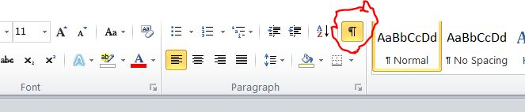
Now you know I don’t draw well with a mouse. J

Slide 15

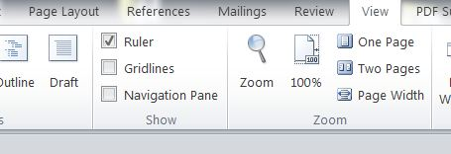
It is also a good idea to turn on the rulers to help you with the spacing. Both the ruler and the grid lines are available on the View Table in the show section of the Word Ribbon.

Slide 16
Once you are ready for placement simply go to the Insert Tab > Illustrations Section> Picture > select your image from your computer and click Insert. It is very likely that you will need to resize this image to fit your space. If you are making 2 of the same card copy and paste the resized image rather than pasting and resizing again. You might want to save at this point in case you want to edit it later. To check that the page will print correctly click File> Print and the print preview shows to the right of the screen. If your images are not where you want them go back and adjust or, if they are cut off you might need to adjust the margins or resize.
If you are creating the greeting on the inside repeat the process on page 2 or on a new file.

Slide 17

Don’t forget to SAVE before attempting to print. You can always delete files when you are done!!!

Slide 18

Printing on Both Sides
This will get a bit confusing but play with a piece of regular paper and it will become clear.
Now to print your card you may need to play a bit with text weight paper until you figure out just how your printer works. I will tell you how I do mine. Put the cardstock in the paper tray. I only use one sheet at a time for double sided printing because I discovered that my printer preloads the next sheet. Never knew that until I tried to print on both sides for this project.
Go to File > Print>Settings and, where it says Print all pages, click the down arrow. Click Print Custom Range and enter 1 where it says Pages. Click Print.
When the page comes out of your printer turn the paper so that the images are face up and to the right. Replace it in the paper tray.
Now change the number where it says Pages to 2 and click print.
You are now ready to cut your cardstock in half, color the images and fold your card.

Slide 19

Printing a Hybrid Card
For a hybrid card just place the elements (images and sentiments) on the sheet of cardstock and print.
It is possible to create an area with the Auto shapes and flood fill it but this uses a huge amount of ink. I prefer to just cut background areas from colored cardstock.
Once you have these elements just color, cut and assemble.

Slide 20
Give it a try
but remember I am not responsible for how addictive this can be.

