Slide 1
Freeware, Shareware, Inexpensive Software
From nearly essential for all to
Amazingly labor saving at work to
übergeeky

Slide 2
Essential Freeware
If you are still using Office 2003, there is a Microsoft compatibility pack to read / write the Office 2007 / 2020 file formats:
  http://office.microsoft.com/en-us/support/microsoft-office-compatibility-pack-for-word-excel-and-powerpoint-HA010168676.aspx
If you don’t have any version of Office, there are free viewers to allow you read / print Office files. Example for PowerPoint:
  http://www.microsoft.com/download/en/details.aspx?displaylang=en&id=13
www.openoffice.org is now hosted by the Apache Software Foundation:
  http://www.openoffice.org/

Slide 3
Useful Freeware
Adobe Reader (link)
Adobe Flash (link)
Firefox
Safari
Google Chrome (link)
Sun Java (link)
PDFCreator (link)
Google Earth (link)
Greenfish Icon Editor (link)
How to make custom account pictures (link)
How to add print directory to Windows (link)

Slide 4
Useful Freeware
inSSIDer (link)
Axcrypt (link)
VLC Media Player (link)
MWcalc (link)
ImageJ / Radial Profile Plot (link)
XOP / IMD (optical modeling) (link)
AlternaTIFF (TIFF image viewer for US Patents inline viewing) (link)
Free Patent Fetcher (10 free PDF’s / day)
  http://free.patentfetcher.com/Patent- Fetcher-Form.php

Slide 5
Useful Inexpensive Software
Excel Import Multiple Text Files Software (link)
Business Card Designer Plus (link)
DigitizeIt (link)
Second Copy (link)
Outlook Shutdown addin (link)
Bizcalc (link)
PerfectDisk (link)
Master Cook 11 (link)
  RecipeFox for Firefox

Slide 6
Adobe
Adobe Acrobat Reader (PDF file viewer)
  http://get.adobe.com/reader/
    (be sure to deselect Google Toolbar if you don’t want it)
Adobe Flash (video viewer)
  http://get.adobe.com/flashplayer/
    (be sure to deselect Google Toolbar if you don’t want it)
Return

Slide 7
Alternative Browsers
Firefox
  http://www.mozilla.org/en-US/firefox/new/
Google Chrome
  https://www.google.com/chrome
Safari
  http://www.apple.com/safari/
Return

Slide 8
Sun Java
Download link:
  http://java.com/en/download/index.jsp
  (uncheck add-ons that you don’t want)
  Note: uncheck Ask toolbar / default search if don’t want
Version check:
  http://www.java.com/en/download/installed.jsp
May need to install into alternative browsers / authorize installation of add-in
Return

Slide 9
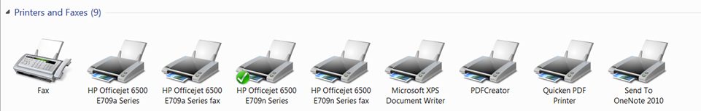
PDFCreator
Download link:
http://sourceforge.net/projects/pdfcreator/
Creates a virtual printer that is accessible from any application
Return

Slide 10
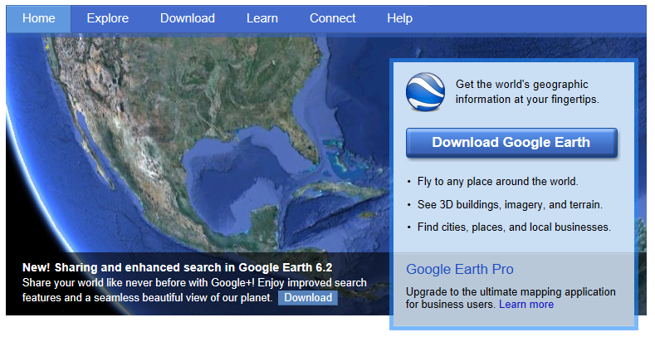
Google Earth
Download link:
http://www.google.com/earth/index.html
Google Earth Demo
Return

Slide 11
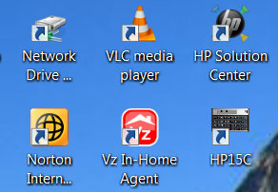
Greenfish Icon Editor
Allows creation / editing of custom icons
Download link:
http://download.cnet.com/Greenfish-Icon-Editor-Pro/3000-2193_4-10773415.html?tag=mncol;1
Custom icon
Return

Slide 12
Custom user account picture
Windows 7 default location:
C:\ProgramData\Microsoft\User Account Pictures\Default Pictures
You can add your custom pictures to the above location so that the user accounts applet lists them automatically. Ensure that the dimension of the picture is 128x128 pixels, and it's a Bitmap image (.bmp).
Return

Slide 13
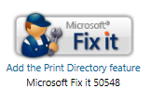
How to add print directory command to Windows
http://support.microsoft.com/kb/321379
This page has a Microsoft Fix-It:
After running this, right clicking on folder now give the option to print directory
Return
DEMO

Slide 14
inSSIDer
– Inspect your Wi-Fi and surrounding networks
– Scan and filter hundreds of nearby access points
– Troubleshoot competing access points and clogged Wi-Fi channels
– Highlight access points for areas with high Wi-Fi concentration
– Track the strength of received signals in dBm over time
– Sort results by MAC Address, SSID, Channel, RSSI, Time Last Seen
Download link:
http://www.metageek.net/products/inssider/
If issue with current version, I have the installer file for a known stable version
inSSIDer DEMO
Return

Slide 15
Axcrypt
East to use encryption software
Encrypts / decrypts individual files / folders
Adds to Windows right click context menu
Double clicking encrypted file brings up Axcrypt menu; closing file automatically re-encrypts file / bleaches clear text file
Information / download link:
  http://www.axantum.com/axcrypt/
Return

Slide 16
VLC Media Player
Versatile media player
I used it to capture streaming video from an IR camera on the local network (the camera software could only capture stills)
Download link:
http://download.cnet.com/VLC-Media-Player/3000-13632_4-10267151.html?tag=mncol;1
Return

Slide 17
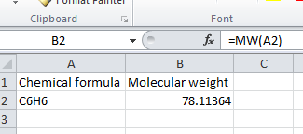
MWcalc
Excel addin to calculate molecular weight
Place the DLL in Office 12 / library or Office14 / library and activate the add-in
Result:
Works with Excel 97 through 2010
Information and Download:
http://www.chemicalogic.com/mwcalc/
Return

Slide 18
ImageJ
Sophisticated image analysis program, originally written at NIH for the early Mac, since ported to Java
Has many useful plugins that extend capability, including Radial Profile Plot
Documentation and download link:
  http://rsbweb.nih.gov/ij/
Radial Profile Plot:
  http://rsbweb.nih.gov/ij/plugins/radial-profile.html
Return

Slide 19
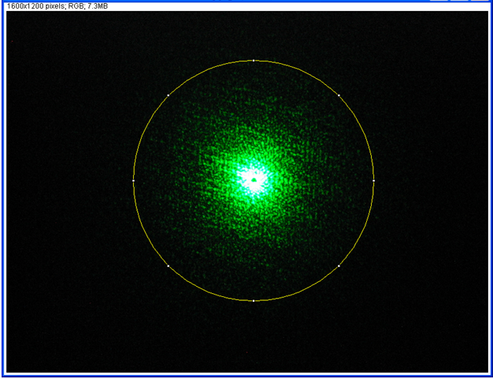
Image

Slide 20
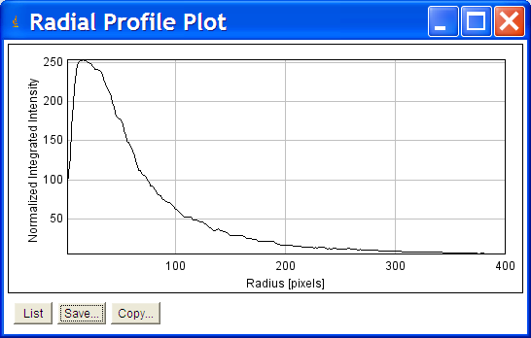
Radial Profile Plot
Numerical values can be exported to tab delimited text file for import into Excel
Return

Slide 21
XOP / IMD optical modeling
Freeware that did the job of very expensive commercial software at zero cost
Interface is a bit funky, but fully useable
  (I can help if anyone is interested)
Optical constants (n, k vs. λ) are in simple text files, so new material can be added in same format
Information and download link:
  http://www.esrf.eu/computing/scientific/xop2.1/extensions.html

Slide 22
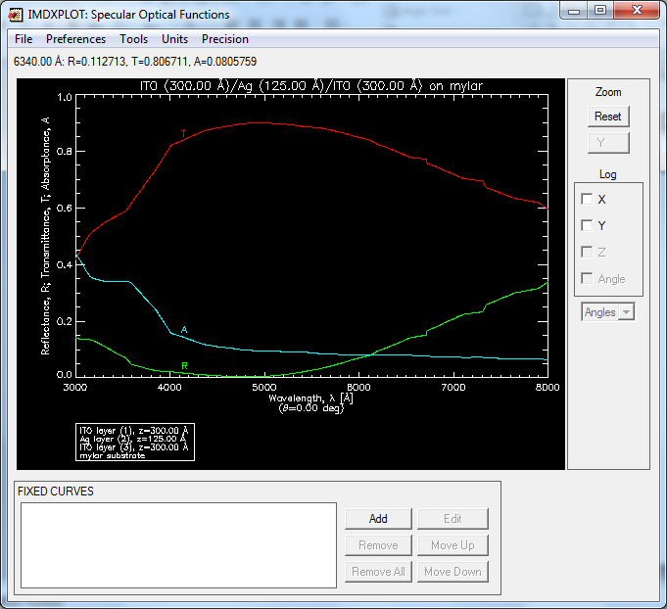
XOP / IMD modeling example
(3 layer heat mirror on PET plastic)
Return

Slide 23
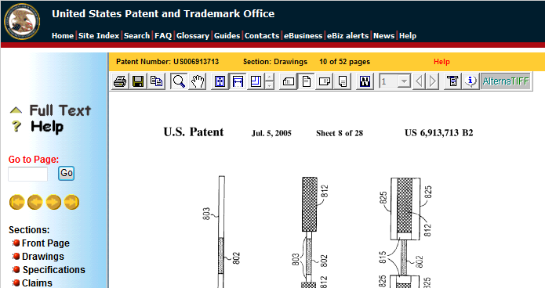
AlternaTIFF
TIFF Image viewer browser add-on for inline viewing of US Patents
Download link:
  http://www.alternatiff.com/
Return

Slide 24
Excel Import Multiple Text Files Software ($29.99)
I had tasks with sets of 150 text files of data that had to be imported into Excel; the first set of 150 took several hours of tedium (one at a time)
Excel Import Multiple Text Files Software did the next set of 150 in 3 minutes!!!
Information / trial download /purchase link:
http://www.sobolsoft.com/exceltext/
DEMO
Return

Slide 25
Business Card Designer Plus ($29.99)
Easy to use business card design software
Automatically formats for printing onto pre perforated business card stock on ink jet printer
Information / download / purchase:
  http://www.camdevelopment.com/designer/business_card/
DEMO
Return

Slide 26
DigitizeIt (€ 39 / $ 49)
If you have a graph from a publication and need numerical data, this is for you!
MUCH less tedious and more accurate than doing it by hand
Information / download / purchase:
  http://www.digitizeit.de/
DEMO
Return

Slide 27
Second Copy ($29.99)
Powerful, versatile backup utility
Can run automatically, or in manual mode
Information / download / purchase:
  http://www.secondcopy.com/index.html
Return

Slide 28
Outlook Shutdown add-in ($4.99)
STOP USING TASK MANAGER TO KILL OUTLOOK.EXE!
Are you frustrated like I am that Microsoft Outlook doesn't shutdown? When you exit Outlook does it stay running the background wasting system resources? Well if you are then you need Shutdown Addin.
Information / download / purchase:
  http://www.daveswebsite.com/software/olshutdown/
Return

Slide 29
Bizcalc ($14.95)
BizCalc is an intuitive, feature-rich programmable business and financial software that fully emulates the famous HP-12C calculator.
Uses RPN logic.
Information / download / purchase:
  http://www.odysseyinc.com/oldsite/subpages/Software/BizCalc/index.htm
DEMO
Return

Slide 30
PerfectDisk 12.5 Pro (1 PC: $24.99,
3 PC: $29.99)
Superior disk defragmentation
Allows defragging of system files
Includes SSD optimization
Have personally used on all my machines and friends machines (both standard and SSD drives)
Information / download / purchase:
  http://www.raxco.com/home/home-professional.aspx
Return

Slide 31
Mastercook 11 ($19.95)
Recipe management software
Comes with hundreds of recipes
Easy to add recipes / cookbooks
Direct import from web using Internet Explorer native; Firefox with Recipefox add-in
Can create shopping lists / export to iPhone app
Information / purchase:
http://www.valusoft.com/DRHM/store?Action=DisplayProductDetailsPage&SiteID=valusoft&Locale=en_US&productID=183067000
DEMO
Return

Slide 32
Recipefox add-in for Firefox (free)
Download the latest version from SourceForge; the version on the Firefox add-in page is NOT up to date and may not run with the current version of Firefox
http://sourceforge.net/projects/recipetools/files/RecipeFox/
Return

