Slide 1
Cloud Drives, especially Google Drive
Also Google Docs, Sheets, and Slides

Slide 2
Cloud Drives
There are many vendors of cloud drive services
I use:
  Google drive (personal, consulting group, church)
  Microsoft OneDrive
  Elephant Drive
  Apple iCloud Drive
Many other vendors, e.g. Dropbox, Box, Amazon Cloud Drive

Slide 3
Cloud drive uses
Offsite backup; disaster insurance
Supplementary storage capacity
Cross platform accessibility: PC, Mac, iOS, Android

Slide 4
Cloud Drive Horror Story
Used Mozy backup to backup NAS used for PC backup
Drive failed, RAID controller copied failed drive to second drive
Mozy backup of device had been terminated without notification
With difficulty was able to recover files using a combination of file recovery software on failed drive and an old backup on a lab PC.
MORAL#1: Stay current on status of cloud drives. Make sure cloud service provider stays in business!!!
MORAL#2: Backup your backups, and backup the backup of the backup

Slide 5
Cloud storage comparison
 | OneDrive | Dropbox | Google Drive | Box | Amazon Cloud Drive
File size restrictions? | 10GB | 10GB with website, none with Dropbox apps | 5TB | 250MB for free plan, 5GB for paid personal plan | 2GB*
Free storage? | 5GB** | 2GB | 15GB | 10GB | No***
Can I earn extra free storage? | No** | Yes | No | No | No
Paid plans | $2/month for 50GB** | $10/month for 1TB | $2/month 100GB, $10/month for 1TB | $10/month for 100GB | $12/year for unlimited photos, $60/year for unlimited files
OSes supported | Windows, Mac, Android, iOS, Windows Phone | Windows, Mac, Linux, Android, iOS, Windows Phone, BlackBerry, Kindle Fire | Windows, Mac, Android, iOS | Windows, Mac, Android, iOS, Windows Phone, BlackBerry | Windows, Mac, Android, iOS, Kindle Fire
https://www.cnet.com/how-to/onedrive-dropbox-google-drive-and-box-which-cloud-storage-service-is-right-for-you/

Slide 6
Google Drive
15 GB free
$2 / month for 100 GB
I have free Google drive for personal use, my wife has one for her personal use
We have a 100 GB $2 / month for cloud backup of data for Lowell Consulting Group

Slide 7
How to use Google Drive
Sign up for Gmail
Sign up for Google Drive
Download Google Drive for PC
Google Drive shows as a folder on your PC
  C:\Users\Bob\Google Drive
Files copied to Google drive folder are synced to the cloud automatically
Files added to Google Drive from other devices automatically synced to Google drive folder on PC

Slide 8
Example: Lowell Consulting Group
We have very large number of small data files from performance testing of devices
We use Second Copy to automatically copy in real time the folder containing the data file folders to the Google drive folder on the PC.
Google Drive syncs this folder to the cloud so that we all can access the data from our PC’s, Mac’s and phones from wherever.

Slide 9
Accessing Google Drive
Folder on PC
Website
App on iPhone, iPad
Limitation: can only see one Google Drive at a time.
On PC, ExpanDrive ($49.99 single user, multiple PC’s) allows mapping of multiple Google Drives
DEMO

Slide 10
Accessing Google Drive
iPhone, iPad app FileBrowser ($5.99) removes one Google Drive limitation (and allows two way file transfer between iOS devices, cloud drives and PC’s)

Slide 11
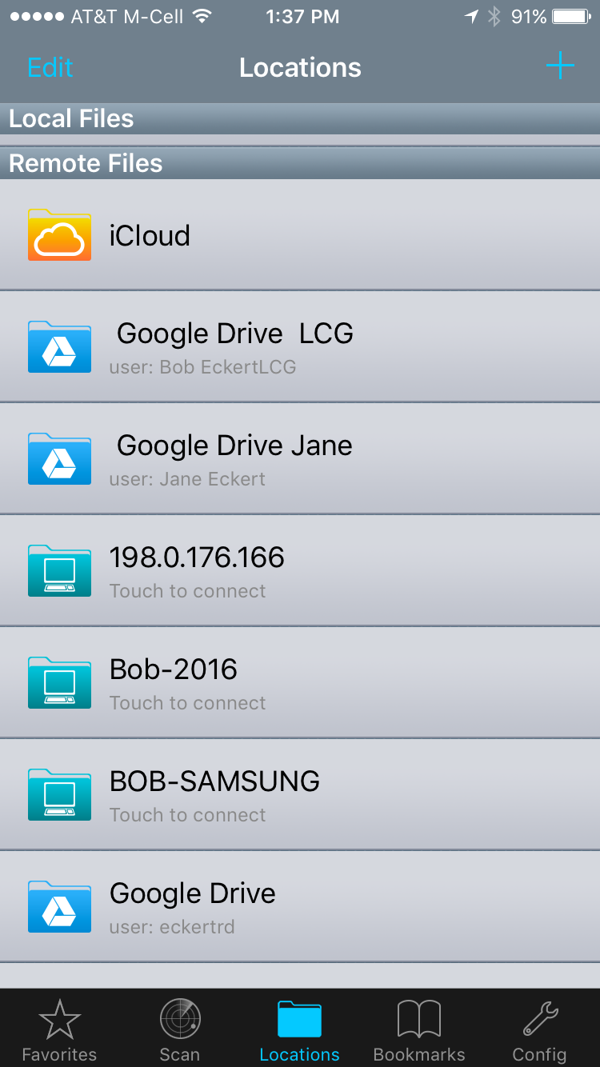
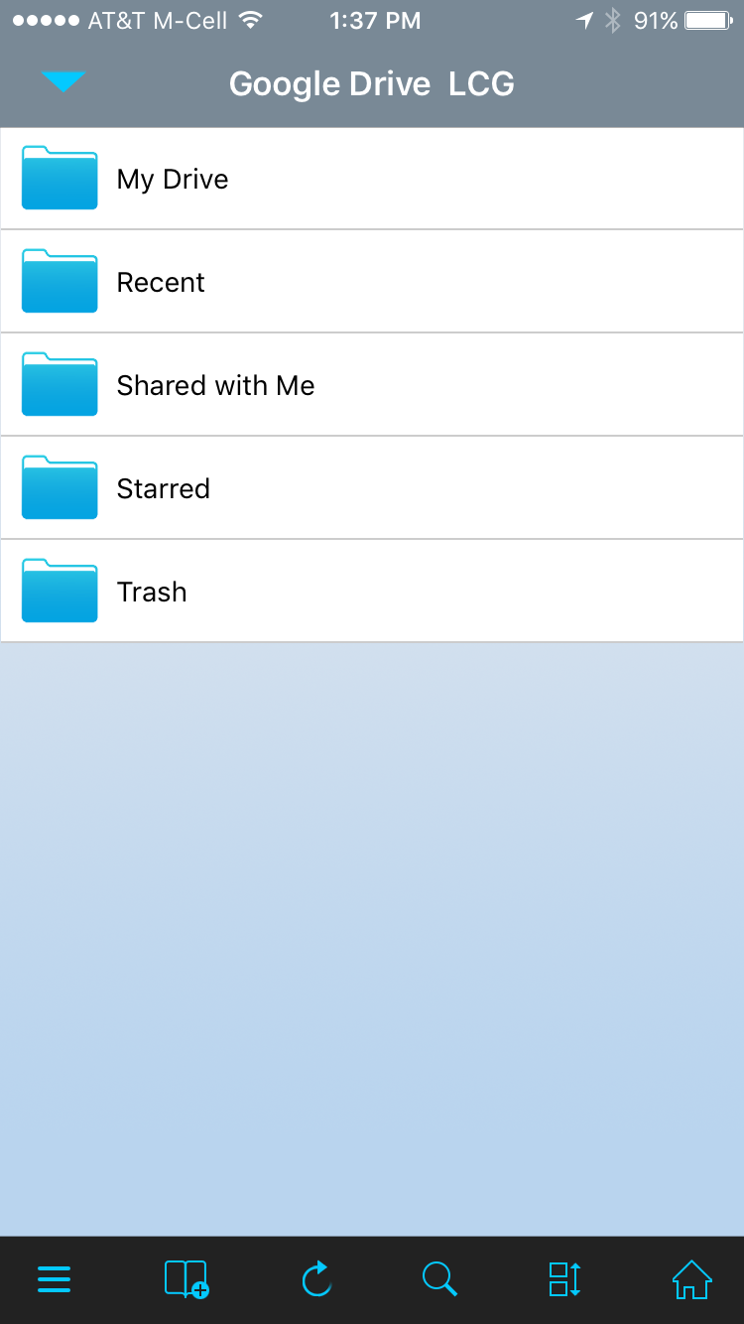
FileBrowser iPhone interface

Slide 12
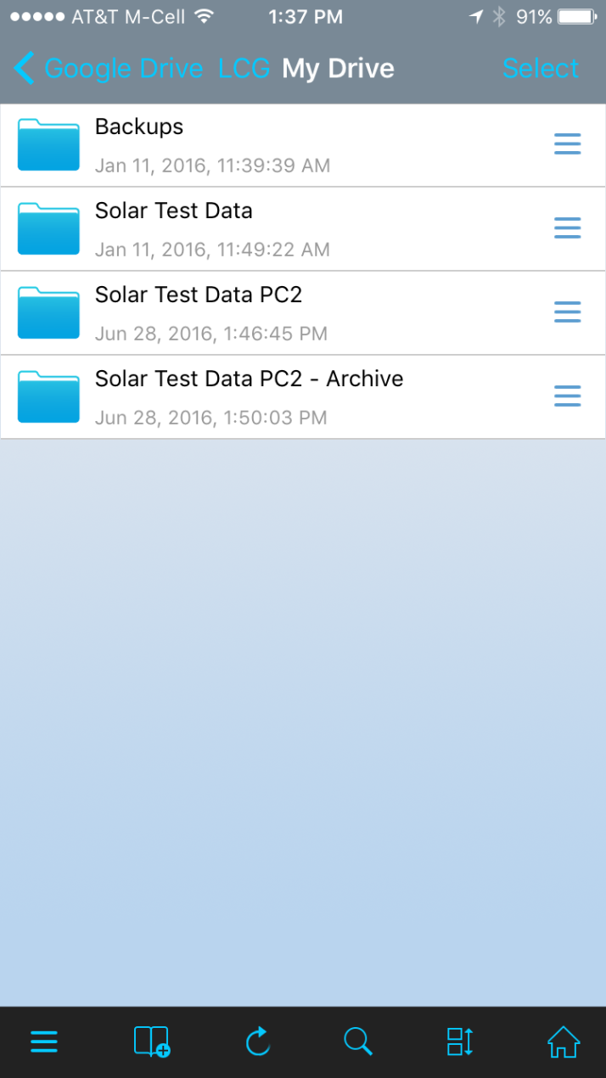
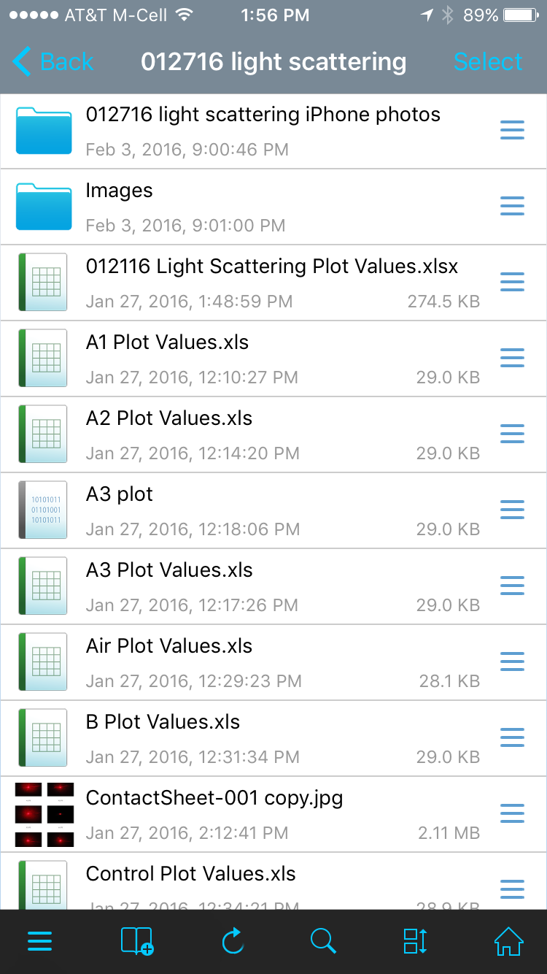
FileBrowser iPhone user interface

Slide 13
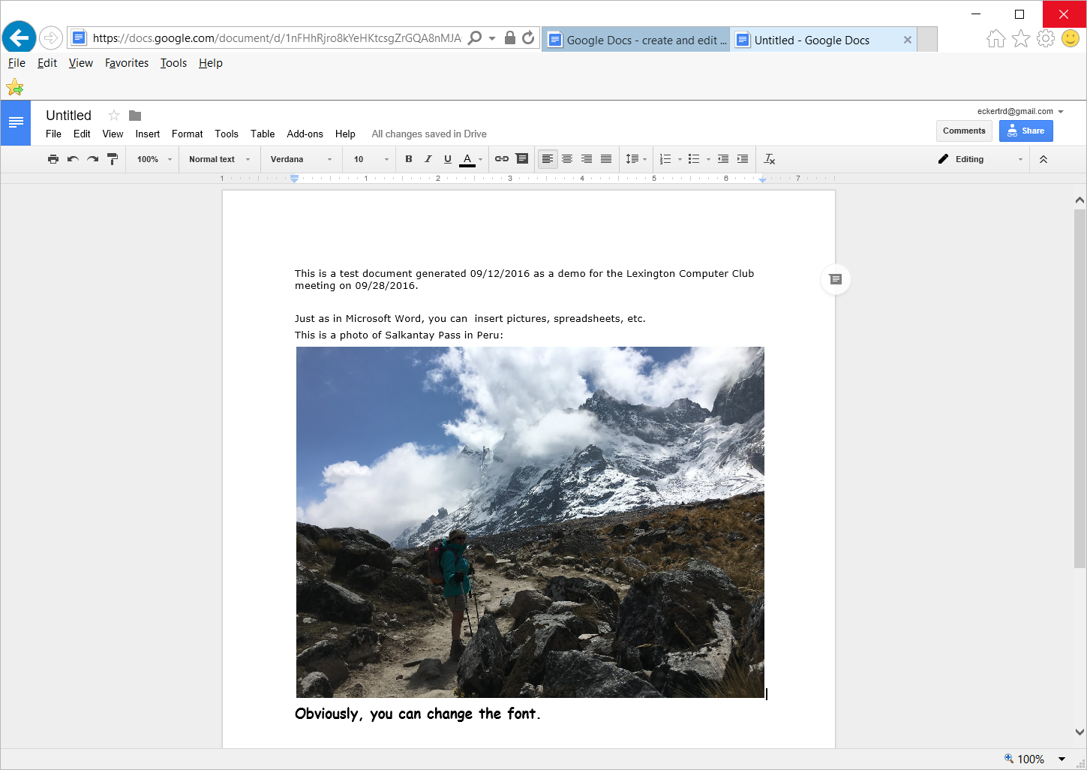
Google docs

Slide 14
Google Docs basics
Get to Google Docs:
https://www.google.com/docs/about/
Click button; sign in if not already.
Default save location is your Google Drive
Can download as MS Word file
DEMO

Slide 15
Collaboration tools
Can share files and folders
https://support.google.com/docs/answer/2494822?hl=en&ref_topic=4671185
Google Docs can read and write MS Word .doc and .docx files
Limitation: MS Word, Excel macros will NOT run in Google Docs, Sheets

